Slide 1


Hope to Skills
Lecture# 19
Irfan Malik, Dr. Sheraz Naseer

Slide 2
Agenda
Recap
Scaling
Min-Max Scaling
Z-score scaling
Different Classification models
Notebook
Quiz

Slide 3
Scaling
Min Max Scaling
Z-score Scaling

Slide 4
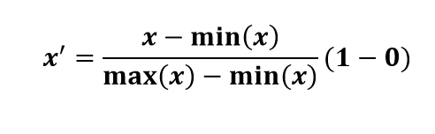
Min-Max Scaling
Min-Max Scaling is a data normalization technique used to transform data into a specific range.
Formula for Min-Max Scaling

Slide 5
Min-Max Scaling- Example
Example: Normalize the data [200, 300, 400, 600, 1000] for interval [0,1]
Step 1: Find the minimum value (min_X) and maximum value (max_X) in the data..
min_X = 200
max_X = 1000
Step 2: Apply the Min-Max scaling formula to each data point:
For x = 200:
Scaled_x = (200 - 200) / (1000 - 200)*(1 - 0) = 0 / 800 = 0

Slide 6
Min-Max Scaling
For x = 300:
Scaled_x = (300 - 200) / (1000 - 200) *(1 - 0) = 100 / 800 = 0.125
For x = 600:
Scaled_x = (600 - 200) / (1000 - 200)*(1 - 0) = 400 / 800 = 0.5
For x = 1000:
Scaled_x = (1000 - 200) / (1000 - 200)*(1 - 0) = 800 / 800 = 1
scaled data: [0, 0.125, 0.25, 0.5, 1]

Slide 7
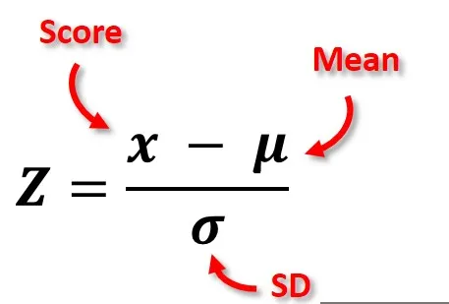
Z-Score scaling
Z-Score Scaling, also known as standardization, is a technique used to transform data into a standard normal distribution.

Slide 8
Z-Score scaling
Example: Normalize the data [200, 300, 400, 600, 1000] using z-score scaling
Step1
Calculate the Mean (μ) of the data.
μ = 500
Step2
Calculate the Standard Deviation (σ) of the data.
σ= 286.4789

Slide 9
Z-Score Scaling
Calculate the Z-Score for each data point:
For x = 200:
z = (200 - 500) / 286.4789 ≈ -1.047
For x = 300:
z = (300 - 500) / 286.4789 ≈ -0.698
For x = 400:
z = (400 - 500) / 286.4789 ≈ -0.349
For x = 600:
z = (600 - 500) / 286.4789 ≈ 0.349
For x = 1000:
z = (1000 - 500) / 286.4789 ≈ 1.747

Slide 10
Different Classification Techniques

Slide 11
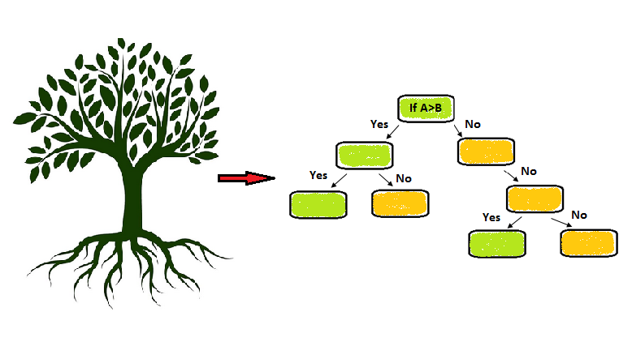
Decision Tree Classifier
A decision tree classifier makes decisions by splitting the data into smaller subsets based on the values of input features, ultimately assigning a class label to each data point. It constructs a tree-like structure of decision rules that can be used for prediction and is easy to interpret.

Slide 12
Random Forest Classifier
Random Forest is ensemble learning method that creates multiple decision trees during training and outputs the average prediction from all individual trees.

Slide 13
Ensemble
Ensemble learning is a machine learning technique that combines the predictions of multiple individual models (learners) to improve overall performance and generalization. Instead of relying on a single model, ensemble methods create a "committee" of models and aggregate their predictions to make a final decision.

Slide 14
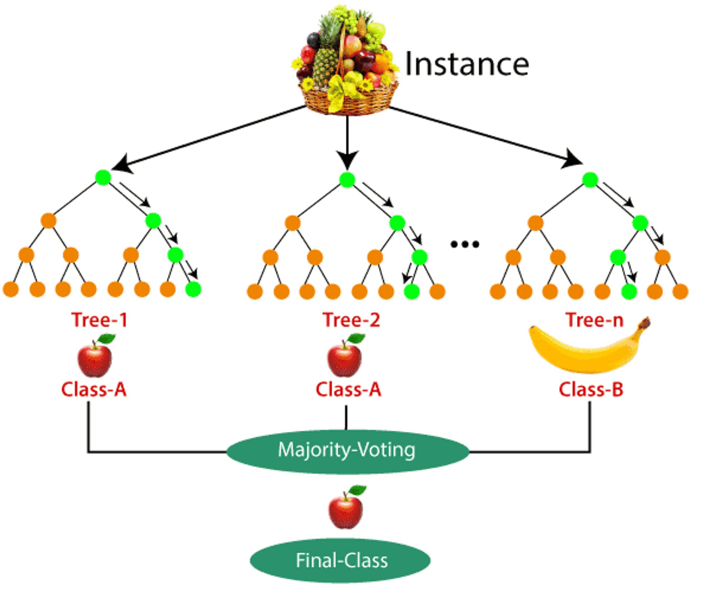
Random Forest Classifier

Slide 15
Gradient Boosting classifier
Gradient Boosting is ensemble learning technique that builds multiple decision trees sequentially, each one correcting the errors of its predecessor.

Slide 16
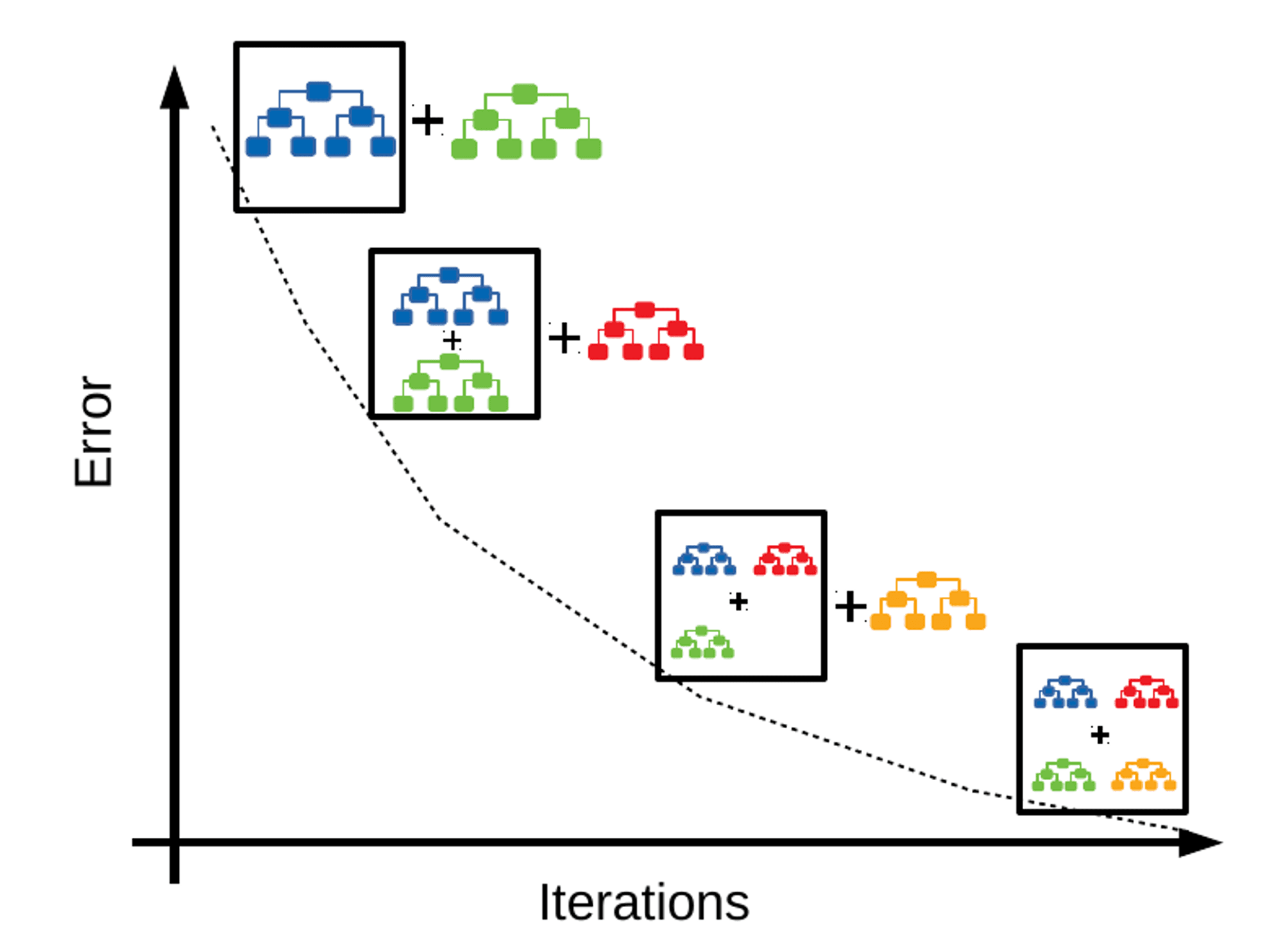
Gradient Boosting classifier

Slide 17
Comparison of Different Classifiers
Logistic Regression: Simple, interpretable, suited for linearly separable data.
Decision Tree: Interpretable, handles non-linearity, prone to overfitting.
Random Forest: Ensemble method, better generalization, less interpretable.
Gradient Boosting: Ensemble, high accuracy, computationally expensive.

Slide 18
Lets move to Google collab

